Slide 1

PYTHON
DATA TYPES

Slide 2
Python Data Types
Built-in Data Types
In programming, data type is an important concept.
Variables can store data of different types, and different types can do different things.
Python has the following data types built-in by default, in these categories:

Slide 3
Python Data Types
Text type Numeric Types Sequence Types Mapping Types Set Types Boolean Types
: str
: int, float, complex
: int, float, complex
: dict, list
: set, frozenset
: bool
Binary types Non Type
: bytes, bytearray, memoryview
: NoneType

Slide 4
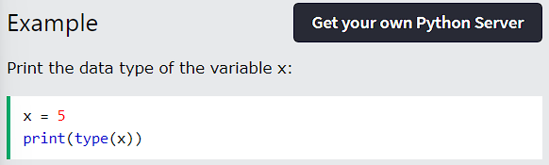
Python Data Types
Getting the Data Type
You can get the data type of any object by using the type() function:

Slide 5
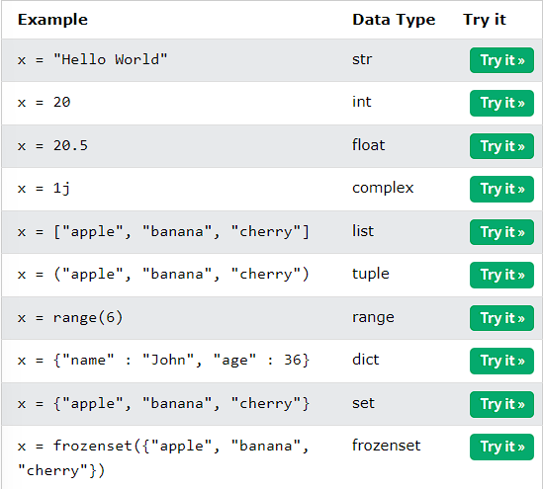
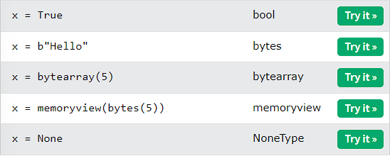
Python Data Types
Setting the Data Type
In Python, the data type is set when you assign a value to a variable:
Python - Data Types

Slide 6
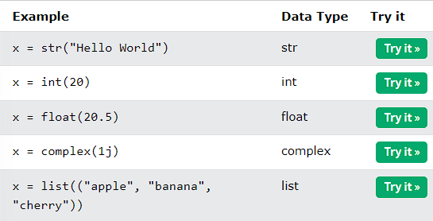
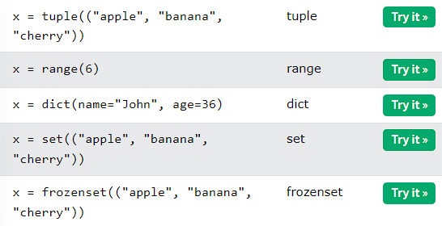
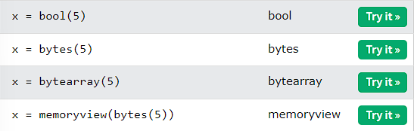
Python Data Types
Setting the Specific Data Type
If you want to specify the data type, you can use the following constructor functions:

Slide 7
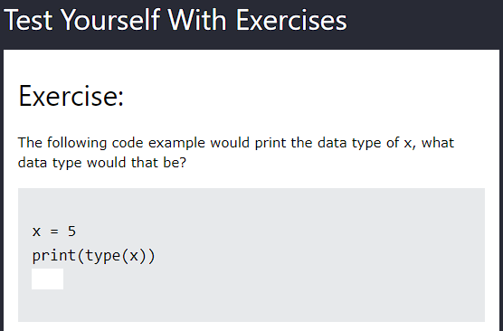
Python Data Types
Python - Data Types

